Slide 1
Ocean model ROMS_AGRIF
&
Processing-tools ROMSTOOLS
http://roms.mpl.ird.fr
Gildas Cambon, Pierrick Penven,
Patrick Marchesiello, Laurent Debreu
gildas.cambon@ird.fr

Slide 2
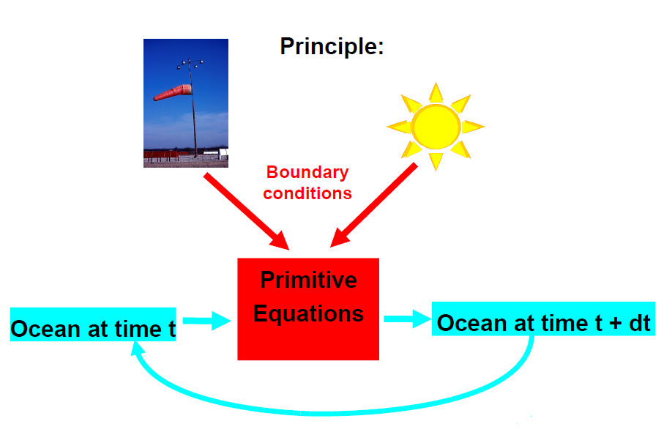
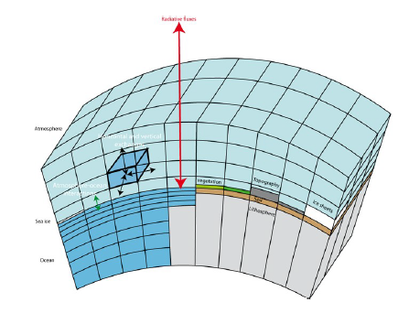
Ocean modeling principle
If we know:
  The ocean state at time t (u,v,w,T,S, …)
  Boundary conditions (surface, bottom, lateral sides)
We can compute the ocean state at t+dt using numerical approximations of Primitive Equations
For that we need to proceed discretization of the equations in time and space:
Example of a finite difference grid

Slide 3
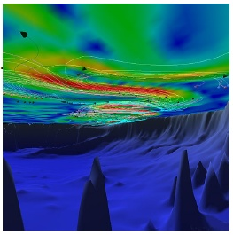
Introduction
Why use of ocean model :
  Cost effective
  Synoptic view
  Equilibrium diagnostics
  Test hypothesis
  Hindcast and forecast
  Coupling with different models
  …
Downloaded from Miami Isopycnic Coordinate model website
4-AGRIF nested grid, SST. Marchesiello et al, Ocean modelling, 2011.

Slide 4
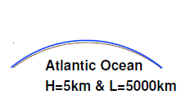
Introduction
Equations to solve:
Navier Stoke equations but with approximations !
Hypothesis:
  Hydrostatic : H/L <<1, (aspect ratio low)
    neglect vertical acceleration
    neglect Coriolis term associated to vertical velocities
  Water is incompressible
  Boussinesq : ρ=ρ_{o}=cste for horizontal gradient pressure
Primitive equations

Slide 5
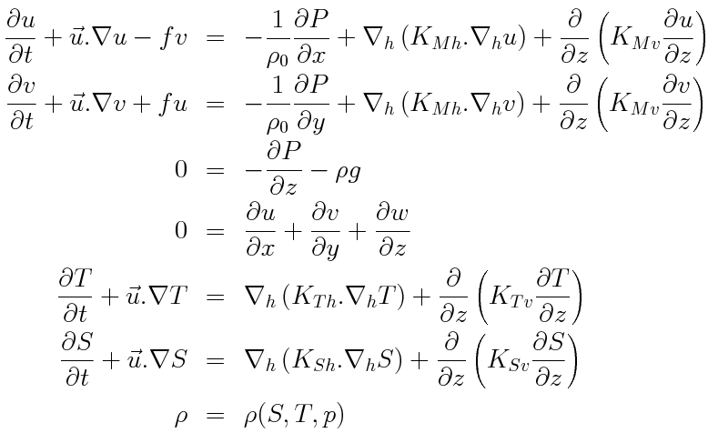
Primitive equations
Momentum
conservation
Hydrostatic
Continuity
Tracer conservation
Equation of state

Slide 6
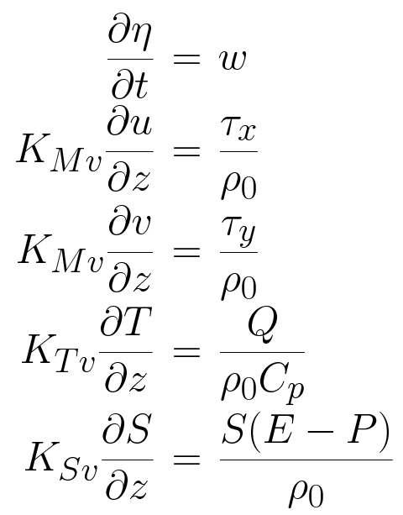
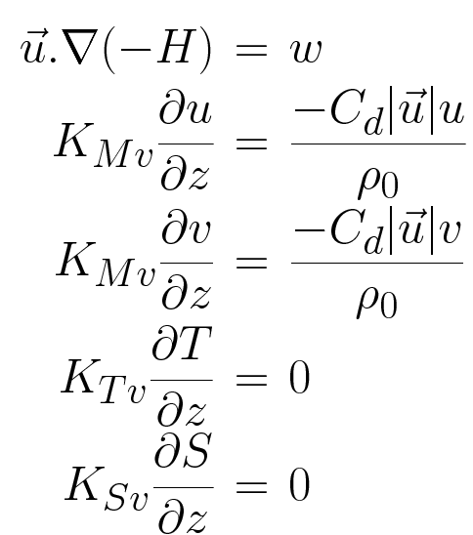
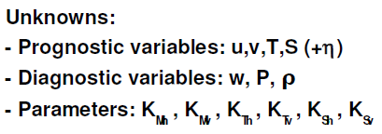
Primitive equations : Boundary conditions
With surface boundary conditions (z=η):
And bottom boundary conditions (z=-H):
Kinematic
Kinematic
Bottom friction
Wind stress
Heat flux
Bottom-flux
Salt flux : evap - rain

Slide 7
ROMS ocean model
ROMS: Regional Ocean Model System
3 version of ROMS:
Rutger University, USA : http://www.myroms.org
UCLA University : http://ww.atmos.ucla.edu.cesr.ROMS_page.html
IRD/INRIA version called ‘ROMS_AGRIF’ version : http://roms.mpl.ird.fr
The practical clases will focuse on this last ROMS_AGRIF version : its main specialty is the online nesting capability using AGRIF (Penven et al, Ocean Modelling, 2006 ; Debreu et al, Ocean Modelling, 2011)
To perform of ROMS simulation, you need :
  Horizontal grid
  Bottom topography
  Land mask
  Surface forcing
  Initial Conditions
  Lateral boundary conditions
Data computed using the ROMSTOOLS

Slide 8
Summary of ROMS characteristics
Solve the primitive equation : Boussinesq approximation + hydrostatic vertical momentum balance
Coastline an terrain following curvilinear coordinate
Split explicit, free surface ocean model : short time steps for barotropic dynamic (ssh and 2D momentum) and a much larger time steps for baroclinic dynamic (T,S, 3D momentum)
Parallelization by two-dimensional subdomain partitioning
Shared and distributed parallelization (OpenMP and MPI)
High advection scheme
Rotated tensors to reduce diapycnal mixing
Improved calculation of horizontal pressure gradient
KPP turbulent closure model (surface and bottom KPP)
Open boundary : Adaptative mixed radiations/nudging open boundary conditions (Marchesiello et al, 2001).
Nesting capability : AGRIF (Adaptative Grid Refinement in Fortran) library .
Sediment module
Several BGC model
Float tracking module

Slide 9
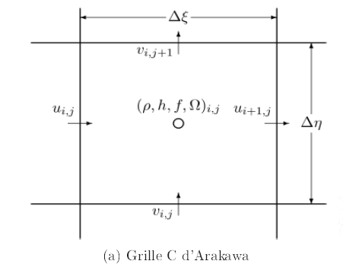
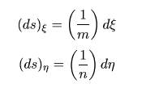
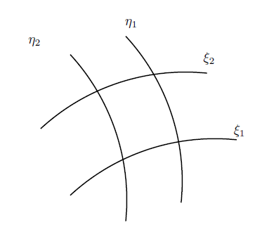
ROMS horizontal grid
Discretized in coastline-and terrain-following curvilinear coordinate
Arakawa C-grid

Slide 10
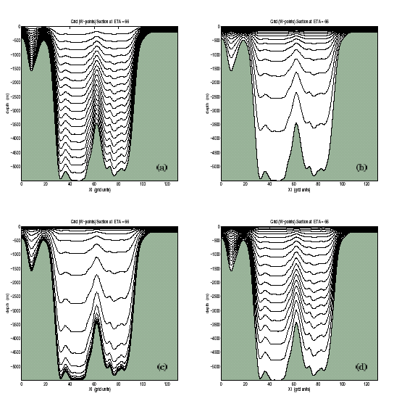
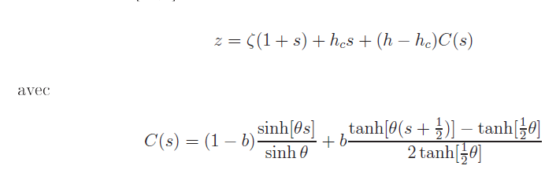
ROMS verical grid : σ generalized coordinate
GENERALIZED σ-COORDINATE
Stretching & condensing of vertical resolution
Ts=0, Tb=0
Ts=8, Tb=0
Ts=8, Tb=1
Ts=5, Tb=0.4
!! Take care of the Pressure Gradient Error on steep slopes !!

Slide 11
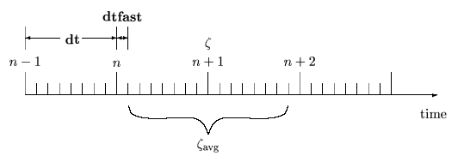
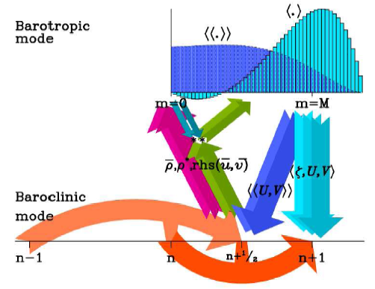
Time splitting and free surface
ROMS resolve free surface using the time-splitting method :
  Direct integration of the barotropic equations
  Getting the free surface is straight forward
  Good parallelization performances
  BUT difficulties to separated fast and slow modes : possible instabilties. To avoid that
    time averaging over the barotropic sub-cycle
    finer mode coupling
ROMS_AGRIF use 3rd order predictor (Leap frog)/corrector (Adam-Moulton) time stepping

Slide 12
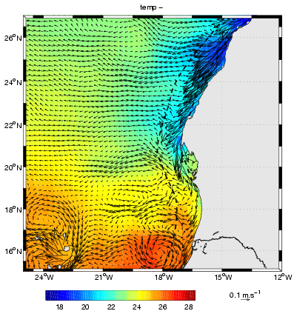
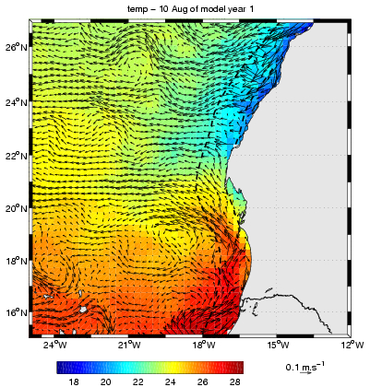
Advection schemes
By default, 3rd order, upstream-biased advection scheme : allows the generation of steep gradient, with a weak dispersion and weak diffusion.
No need to impose explicit diffusion/ viscosity to avoid numerical noise (in case of 3D modeling)
Effective resolution is improved :
OPA - 0.25 deg
ROMS – 0.25 deg

Slide 13
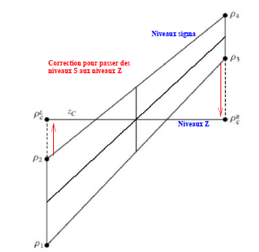


Pressure Gradient force
Truncation errors are made from calculating the baroclinic pressure gradients across sharp topographic changes such as the continental slope
Difference between 2 large terms
Errors can appear in the unforced flat stratification experiment

Slide 14
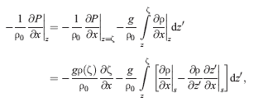
Reducing PGF Truncation Errors
Smoothing the topography using a nonlinear filter and a criterium:
Using a density formulation
Using high order schemes to reduce the truncation error (4th order, McCalpin, 1994)
Gary, 1973: substracting a reference horizontal averaged value from density (ρ’= ρ - ρ_{a}) before computing pressure gradient
Rewritting Equation of State: reduce passive compressibility effects on pressure gradient
r = Δh / h < 0.2

Slide 15
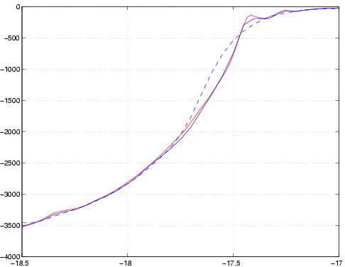
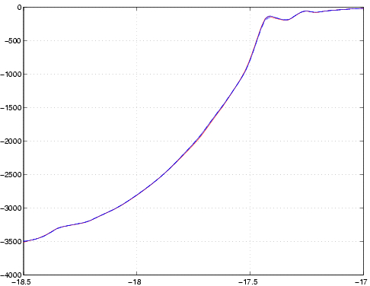
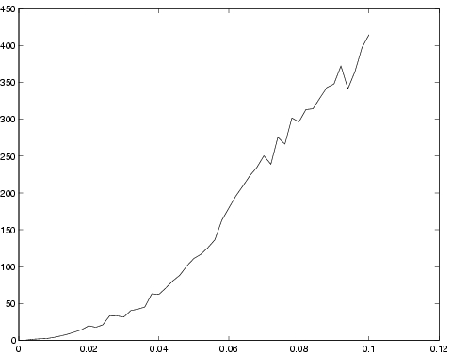
Smoothing methods
r = Δh / h is the slope of the logarithm of h
One method (ROMS) consists of smoothing ln(h) until r < r_{max}
Res: 5 km
r < 0.25
Res: 1 km
r < 0.25
Senegal Bathymetry Profil
Bathymetry Smoothing Error off Senegal
Convergence at ~ 4 km resolution
Standard Deviation [m]
Grid Resolution [deg]

Slide 16
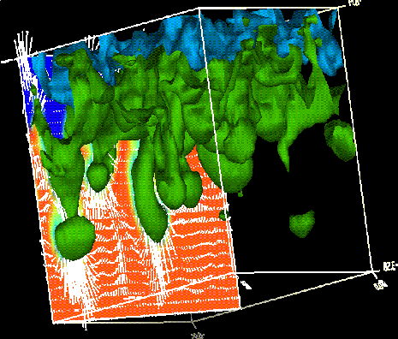

Boundary Layer Parameterization
Boundary layers are characterized by strong turbulent mixing
Turbulent Mixing depends on:
  Surface/bottom forcing:
    Wind / bottom-shear stress stirring
    Stable/unstable buoyancy forcing
  Interior conditions:
    Current shear instability
    Stratification
We look for to determine the vertical profile of K mixing parameter
Reynolds term:
w’T’
K theory

Slide 17
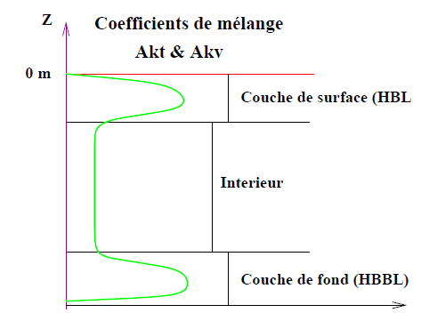
Boundary layer parametrization: KPP
Mixing coefficient profils
All mixed layer schemes are based on one-dimentional « column physics »
Boundary layer parameterizations are based either on:
  Turbulent closure (Mellor-Yamada, TKE)
  K profile (KPP)
Surface mixed layer
Surface mixed layer
Interior
Bottom mixed layer
Principle scheme of KPP turbulent closure

Slide 18
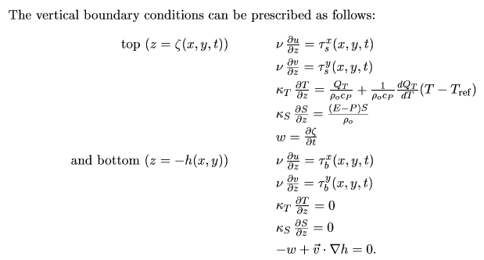

Surface and Bottom forcing
Wind stress
Heat flux
Salt flux
Bottom stress
Drag Coefficient C_{D}:
γ₁=3.10-4 m/s Linear
γ₂=2.5 10-3 Quadratic

Slide 19








Bottom friction parametrization
Linear friction, with r friction velocities [m/s]
Quadratic friction, controled by a constant drag coefficient Cd
Quadratic friction coefficient, using variable Cd (Von Karman log layer)
= Rugosity scale
= thickness of the first bottom level

Slide 20
Air Sea Interaction
Heat fluxes & Freshwater fluxes
Directly read the forcing files
Use of a bulk formulae :
  Heat flux : compute total heat flux from latent, sensible, solar and longwave fluxes and model SST
  Freshwater flux : compute from evap, prate and model SSS
Wind stress:
  Directly read the forcing files
  Compute the windstress from the Cd drag coefficient, model SST and wind stress
bulk_flux.F

Slide 21
Open boundary conditions I (OBC type)
Adaptative mixed radiations/nudging open boundary conditions (Marchesiello et al, 2001).
Radiation, (Orlanski, 1982)
Possibility to use “Flather” OBC conditions for barotropic mode :
  Specially designed for tidal applications
Adaptative nudging term :
Adaptitivity
Ingoing signal (Cx >0) : strong nudging toward external data using
Outgoing signal (Cx >0) : weak nudging toward ext. Data
τ_{M_in} , τ_{M_out} : momentum
τ_{T_in} , τ_{T_out} : tracer

Slide 22
Sponge/Nudging Layer
K^{T}h, K^{m}h profil across sponge layer
Sponge & Nudging Layer
vsponge [m².s⁻¹]
Xsponge [in m]
τ_{out} profil cross nudging layer
Sponge & Nudging Layer
τ_{out}
Sponge : Additional viscosity/diffusivity
Nudging : Add a weak nudging, , toward climatology, if available (see after)
Xsponge [in m]

Slide 23
Open boundary forcing (Clim or Bry)
Different ways to impose OBC
BRY: ‘2D+time’ file (x,z,t) only used at boundaries point : much less data needed !! but no nudging layer (for the moment)
CLIM : ‘3D+time’ files (x,y,z,t) only used at boundaries point + sponge/nudging layer : large amount of data unused.
Data used here only
Data used here only
Sponge/Nudging layer
These type of file 3D (x,y,z) are used for initialization

Slide 24





Tides
The tides are imposed at open boundaries, using the Flather OBC. (OBC_M2FLATHER cppkeys)
  ( ssh and depth averaged zonal and meridian currents) are added at the open boundaries
  are computed from the tidal harmonics given by some tidal model, in our case TPXO7 (0.25° resolution, 10 tidal components : M2, N2, S2, K2, K1, O1, P1,Q1,Ln, Mm
  The global tidal model gives harmonics constants for all the principal tidal waves. These constants permits to compute at every time t, (t(t), , (t), (t) of the tidal wave component N.
  You need :
    Choose the number of tidal wave component you want.
    Interpole on the grid the different harmonic constants
  For the moment, there is no generator potential (for the moment)

Slide 25
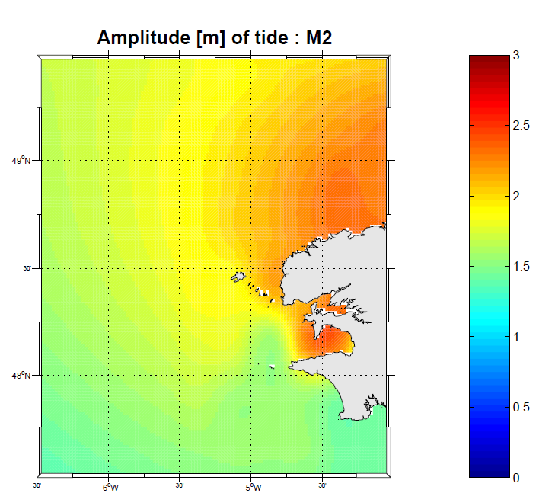
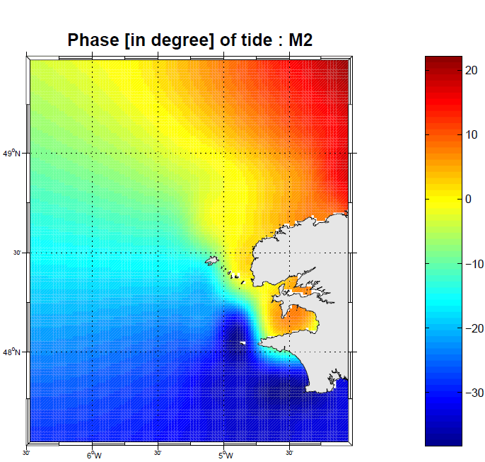
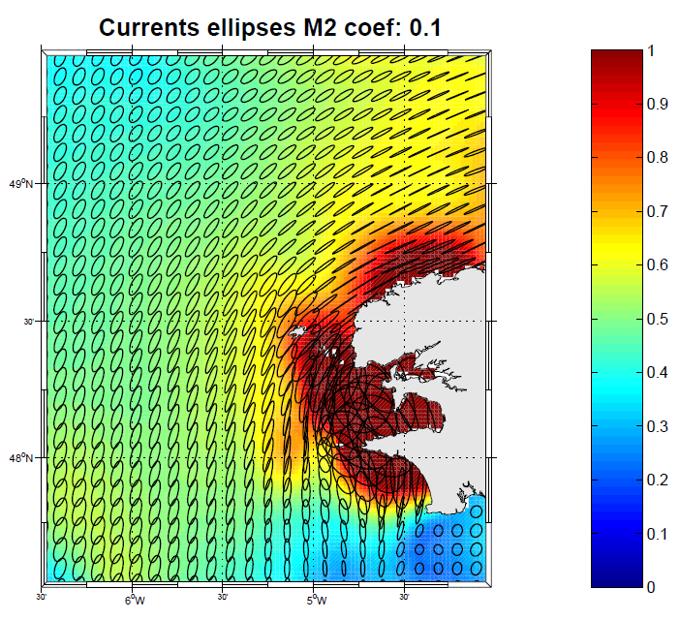
Tides
M2

Slide 26
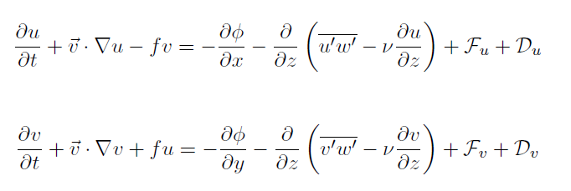

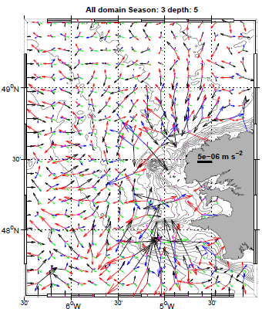



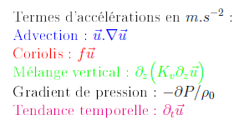
Online Diagnostics :
Momentum equations terms
Rate change term :
Coriolis term :
Advection term :
Pressure gradient term :
Vertical mixing term :
Horizontal mixing term :

Slide 27
Online Diagnostics :
Momentum equations terms
Formulation
flux
BUT take care :
CPPKEYS: DIAGNOSTICS_UV
Storage:
roms_diaM.nc and roms_diaM_avg.nc files.
Can choose in roms.in the writing frequency and the terms to store

Slide 28
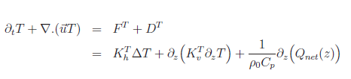
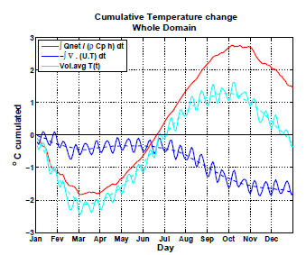
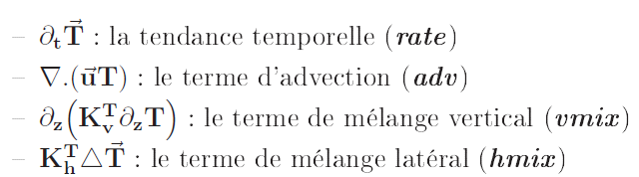

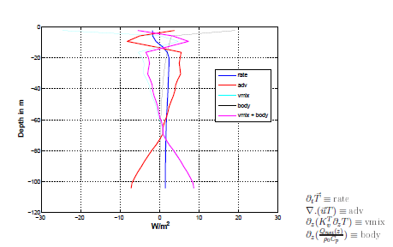
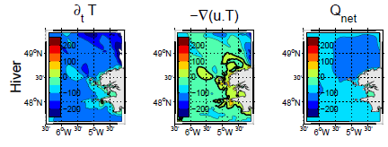
Online Diagnostics :
Tracer equations terms
= Time rate (rate)
= Advection (adv)
Vert. mixing (vmix)
Hori. mixing (hmix)
Solar heating forcing ( body)

Slide 29
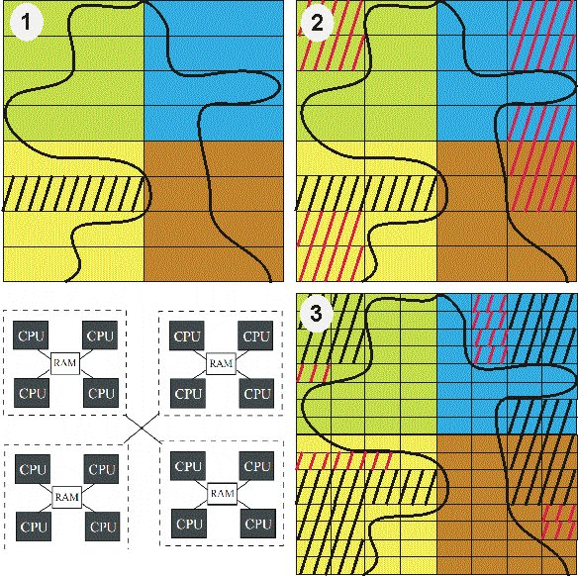
Parallelization
Parallelization by 2 dimensional subdomain partition.
Multiple subdomain can be assigned to each processor.
Parallelization operational on shared and distributed memory computer
Good scaling performance
  ROMS CPPKEYS :
  #define OPENMP
  #define MPI
Ported successfully on different computing center :
  Earth simulator, Idris, Caparmor, Calmip, regional cluster, …

Slide 30
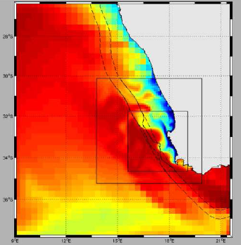
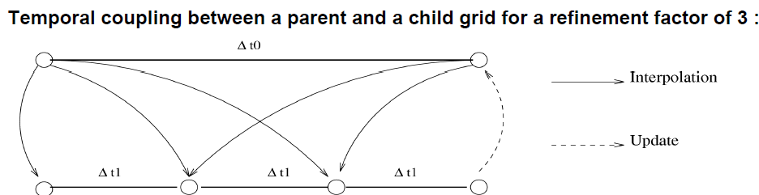
AGRIF Nesting
Nesting capability of ROMS: ROMS_AGRIF
  Manage arbitrary number of fixed grid and embedded levels
  AGRIF : Adaptative Mesh Refinement (http://www ljk.imag.fr/MOISE/AGRIF/)
  1-way and 2 way nesting capability:
    1 way coarse grid feed fine grid
    2 way nesting : feed back of the fine grid on the coarse grid

Slide 31
AGRIF Nesting
The file Agrif_FixedGrids
1
23 37 12 29 3 3 3 3
0
# number of children per parent
# imin imax jmin jmax spacerefx spacerefy timerefx timerefy
# [all coordinates are relative to each parent grid!]
2 grids : #0 and #1
#1 is embedded in #0
1
23 37 12 29 3 3 3 3
1
12 28 15 33 3 3 3 3
0
# number of children per parent
# imin imax jmin jmax spacerefx spacerefy timerefx timerefy
# [all coordinates are relative to each parent grid!]
3 grids : #0,#1 and #2
#1 embedded in #0 ;
#2 is embedded in the #1
For grid #xx :
roms_grd.nc.xx
roms_frc.nc.xx
roms_blk.nc.xx
roms.ini.nc.xx
roms.in.xx

Slide 32
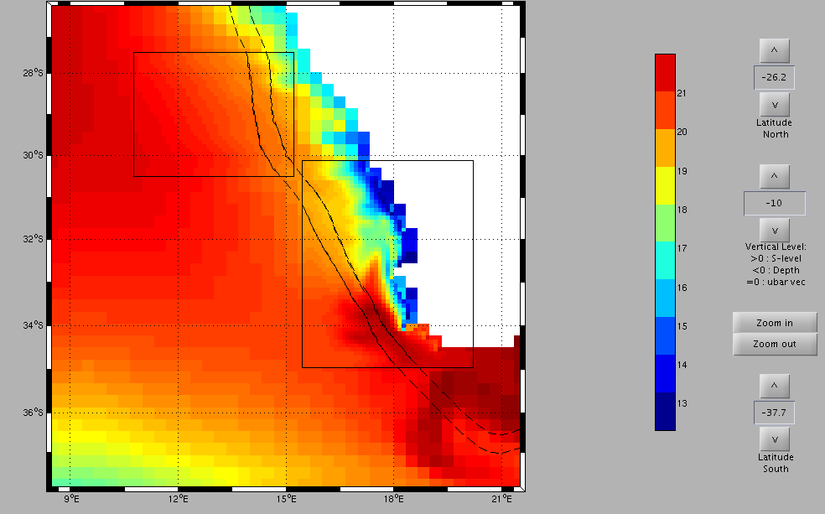
AGRIF Nesting
2
23 37 12 29 3 3 3 3
9 22 28 38 3 3 3 3
0
0
#number of children per parent
# …
3 grids : #0,#1 and #2
#1 embedded in #0 ;
#2 is embedded in #0 : independent grids

Slide 33
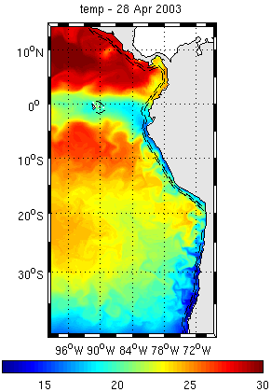
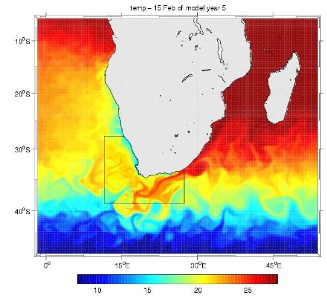
Many realistic applications
4-AGRIF nested grid, SST. Marchesiello et al, Ocean modelling, 2011.
Peru-Chile configuration, Cambon et al
‘SAFE’ Configuration, Penven et al
Others ….

Slide 34
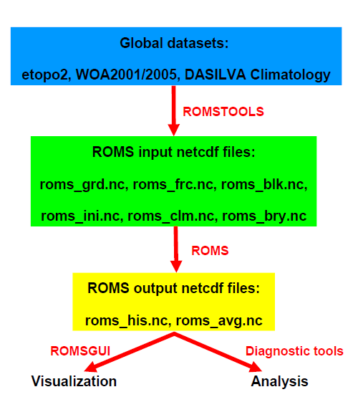
Strategy to build a configuration

Slide 35
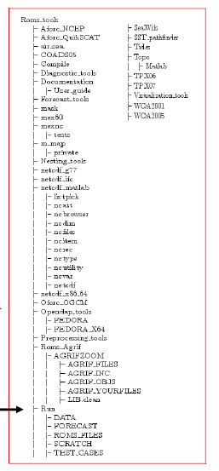
ROMS_AGRIF & ROMSTOOLS modelling system
ROMS : download and untar the file Roms_Agrif_v2.1.
It provides the ROMS_AGRIF fortran code
ROMSTOOLS : download and untar the file ROMSTOOLS_v2.1.tar.gz files.
It provides the matlab routines to pre-process the input file and to visualize them
Utilities_ROMSTOOLS : download and untar the file Utilities ROMSTOOLS.tar.gz files.
It provides the netcdf librairy, mapping toolbox etc …
Datasets : It provides the global datasets needed by the ROMSTOOLS
Directory tree of the system
Work is done in Roms_tools/Run dir

Slide 36
Steps to prepare and run a regional model
Presentation of the main step to run a model of the Southern Benguela at low resolution test case ( 1/3°) with climatological forcings.
Pre-processing data : for that use of ROMSTOOLS matlab toolbox
  Grid and mask creation : make_grid.m
  Atmospheric forcing : make_forcing.m (make_bulk.m)
  Initialization and oceanic forcing at OBC : make_clim.m (make_bry.m)
Preparing and compiling the model : Compilation using jobcomp script
  → executable roms is compiled
Running the model : ./roms roms.in
Vizualize the results : for that use of matlab and the ROMSTOOLS
  Vizualization gui : roms_gui.m

Slide 37
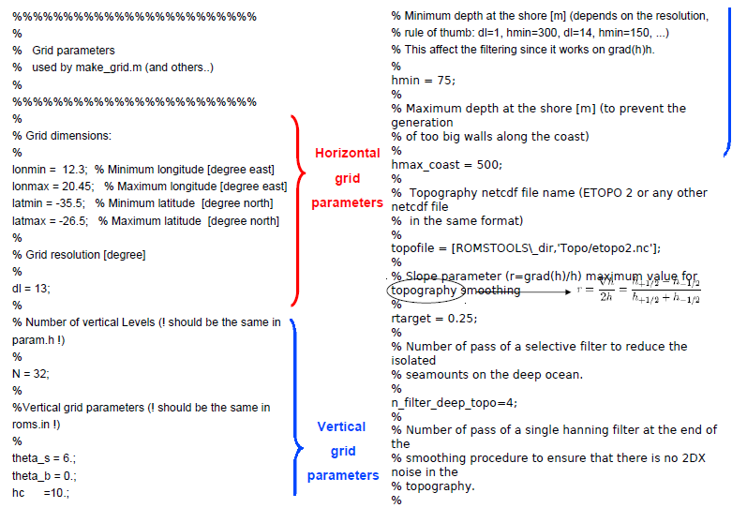
1) Pre-processing data
First : edit general parameters in romstools_param.m file

Slide 38
1) Pre-processing data
Go in the /CMS2011-TP/TP_ROMS/Roms_tools/Run
Launch matlab –nodesktop
>> start : Add all the needed matlab path of the system
>> make_grid
  Horizontal grid : position of the grid points, size of the grid cells
  Bottom topography
  Land mask
>> make_forcing :
  Surface forcing : wind stress, surface heat flux, surface freshwater flux
>> make_ini :
  initial conditions : T, S, currents , SSH
>> make_clim (resp. make_bry)
  Lateral oceanic boundary conditions : T, S, currents , SSH
/ROMS_FILES/roms_grd.nc
ROMS_FILES/roms_frc.nc
ROMS_FILES/roms_ini.nc
/ROMS_FILES/roms_clm.nc (resp. roms_bry.nc)

Slide 39
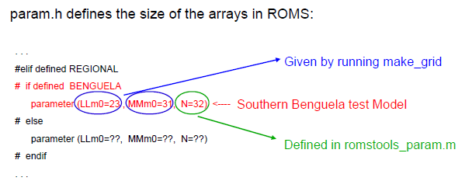
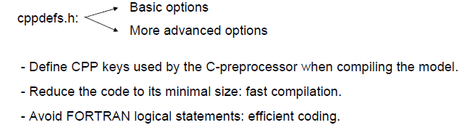
2) Preparing and compiling the model
Edit the param.h and cppdefs.h file to set-up the model

Slide 40
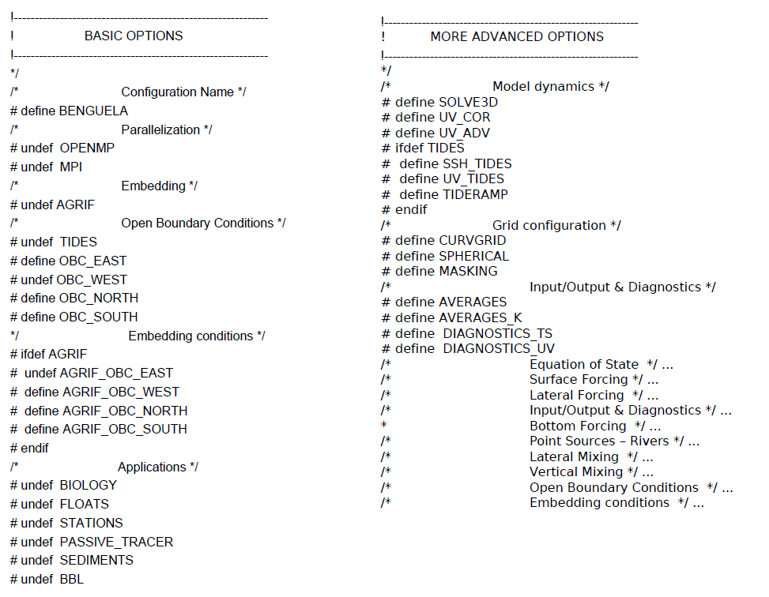
2-Preparing and compiling the model
View
cppdef.h file

Slide 41
2) Preparing and compiling the model
For that use the the jobcomp tcsh file
./jobcomp
Set library path
Automatic selection of option accordingly the platform used
Use of makefile
  C-preprocessing step : .F → .f using the CPP keys defintions (in cppdefs.h file, customization of the code)
  Compilation step : .f → .o (object) using Fortran compiler
  Linking step : link all the .o file and the librairy (Netcdf, MPI, AGRIF) --
  --> produce the executable roms

Slide 42
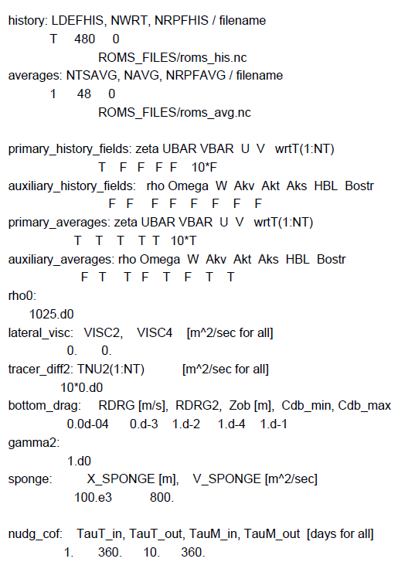
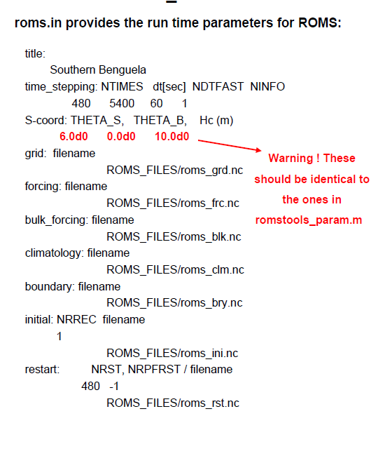
3) Running the model
The namelist roms.in

Slide 43

3) Running the model
Launching the simulation
./roms roms.in

Slide 44

Vizualization
In /CMS2011-TP/TP_ROMS/Roms_tools/Run
$matlab
>> roms_gui

Slide 45

Embedding : Introduction

Slide 46

Embedding

Slide 47
Other ROMSTOOLS processing tools …
Process the tides forcings : make_tides.m
Process the biological forcing : make_biol.m, make_bgc.m, make_pisces.m
Process interanual forcing (atmopsheric and oceanic) using Opendap connection : make_ncep.m, make_OGCM.m
Diagnostics tools
Script to run long simulation (→ roms_YxxMxx.nc) :
  Climatological runs : run_roms.csh
  Interannual run : run_roms_inter.csh
Forecast system using Mercator and NCEP data: make_forecast.m
…

Slide 48

Application module: Overview

Slide 49

Applications module : BGC
Different type of BGC model
  NPZD type model
    NPZD (4 boxes)
    N2PZD2 (6 boxes)
    PISCES (24 boxes)
The BGC variables advected and diffused as tracer in the ROMS kernel.
Treated specifically in bio.F module, after the physical stepping.
CPPKEYS : BIOLOGY
# ifdef BIOLOGY
# undef PISCES
# define BIO_NChlPZD
# undef BIO_N2P2Z2D2
# undef BIO_N2ChlPZD2
Complexity

Slide 50
Application modules
Sediments ( #defined SEDIMENT)
  Compute sediment variables as :
    silt & sand concentration (mg/l)
    porosity of sediment bed layer (m)
    thickness of sediment bed layer
    volume fraction of sand in sediment bed layer
    volume fraction of silt in sediment bed layer
Bottom Boundary Layer ( #defined BBL)
  Compute bottom stresses for combined wave and current (using Soulsby, 1997) :
    Bed Wave excursion amplitude (m)
    Bed ripple height and length (m)
    Physical hydraulic bottom roughness (m)
    Apparent hydraulic bottom roughness (m)
    Wave induced kinematic bottom stress (N/m²)

Slide 51

Application modules
Lagrangian floats ( #defined FLOATS)
  Tracking of lagrangian particules after injected in the domain :
    position
    depth
    temperature, salinity, density
    neutral or not density
    …
  Initialisation cane be done using initfloats.m in Roms_tools/Roms_Agrif

Slide 52



Offline tools
“Offline” nesting Roms2Roms (Evan et al, 2010, Ocean Modeling):
  Processing of roms OBC using the output of a larger roms simulation.
  Enable offline oceanic downscalling
1/6°
1/12°

Slide 53

Offline tools
Offline Lagrangian tracking :
  Tracking of floats injected in the domain, but using the output to process the advection.
    More flexible
    Can reprocess the numerical experiment
    But loss of information (offline !)
  Tools available
  Roff (Capet et al) : http://www.atmos.ucla.edu/~capet/index.html
  ARIANE (Blanke et Grima, LPO, France)
  http://stockage.univ-brest.fr/~grima/Ariane/

Slide 54


Offline tools
Example of ARIANE use :
  Tidal front in Iroise Sea, PhD Gildas Cambon
  http://www.legos.obs-mip.fr/~cambon/

